Slide 1

ANALYSIS OF THE IMPACT OF
COVID19 OUTBREAK ON THE
INDIAN BANKING SYSTEM
By- Krishnakanta Maity
Under Supervision of
Dr. Prasenjit Chakrabarti
Dept. of Accounting and Finance, IIM Ranchi
Guide: Br. Mrinmay

Slide 2
Why this topic?
India, which has a mix of state-owned banks and private sector banks, provides an ideal setting to explore the impact of COVID19 crisis.
In general most of the people’s perception during crisis is withdraw money from private sector and deposit into public sector.
Similarly in any crisis time, peoples started investigating market in detail and managers does not withhold bad news anymore and then stock price drop.
Using crash risk and several fixed effects we are trying to verify the above facts.

Slide 3
Objective
Checking whether crash risk of firms who took loan(s) from vulnerable bank is high or not compared to non-vulnerable bank during COVID crisis.

Slide 4
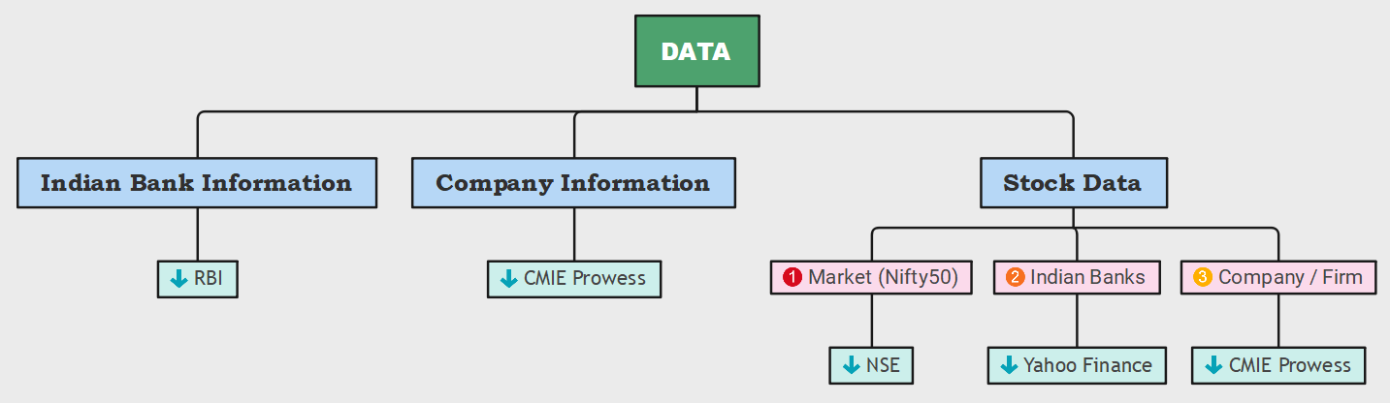
Data Description
Number of Bank:
12 Public Bank
17 Private Bank
Considered time period:
Initial stage of COVID: January 2019 to June 2019
Before COVID: July 2019 to December 2019
During COVID: January 2020 to June 2020
Number of Company: 2280
Number of production area: 151
Computer software
General Purpose Machinery
Drugs & Pharmaceutical
etc. ….

Slide 5
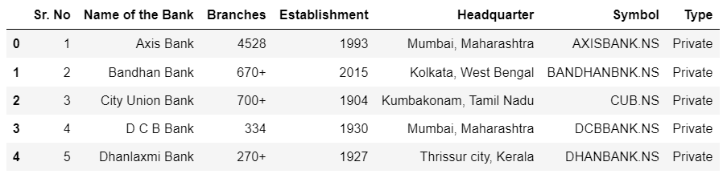
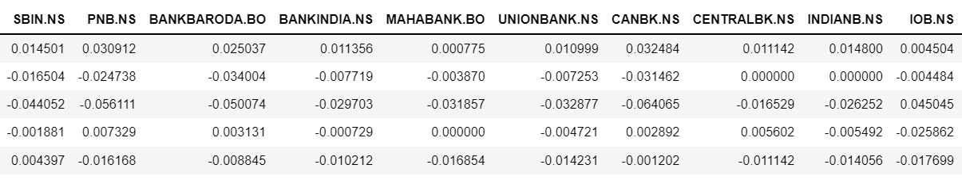
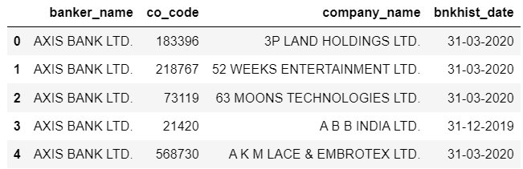
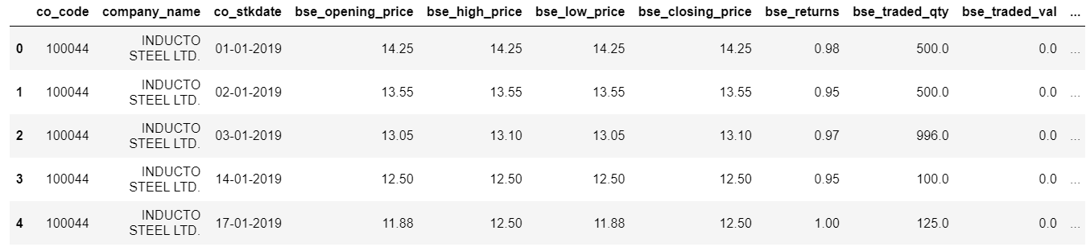
Snapshot of Data
RBI
Yahoo Finance
CMIE Prowess

Slide 6
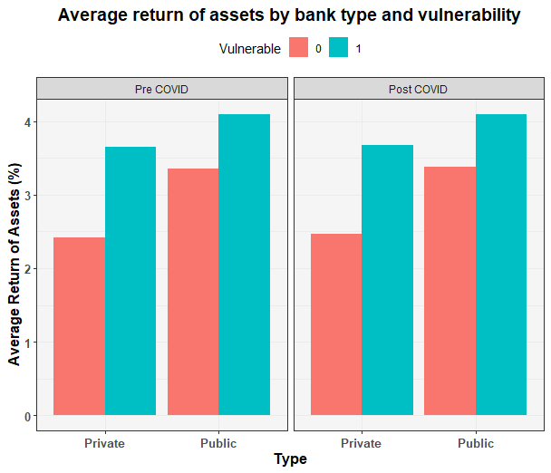
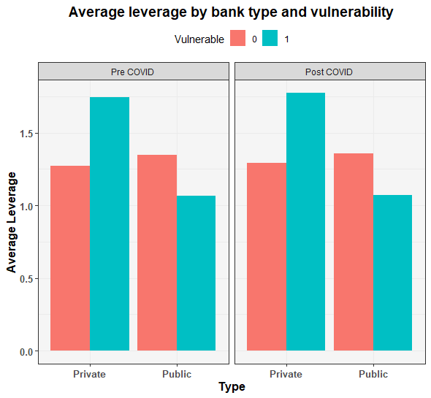
Exploratory Data Analysis
Descriptive Insights
Private sector have more vulnerable bank compared to public sector.
Public banks gave loan to the more banks.
In public sector top lending bank is SBI.
In private sector top lending bank is HDFC.
Top three industries are fund based financial services, wholesale trading and drugs & pharmaceuticals.
Most of financial service firms are taken loan from private sector banks (HDFC, AXIS).
Average return of assets is more for the firms who took loan from vulnerable banks.
Average leverage is quite high for the firms who took loan from private vulnerable banks compared to public vulnerable banks.

Slide 7
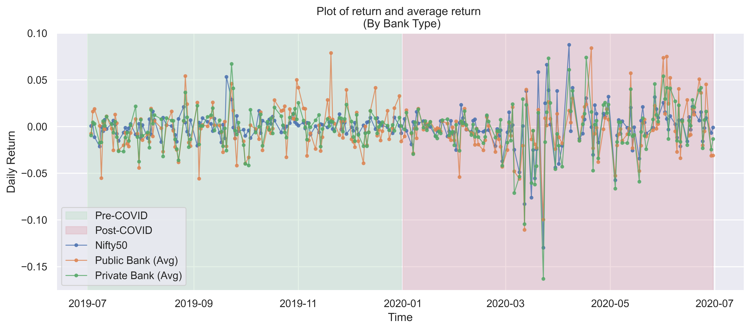
Exploratory Data Analysis

Slide 8
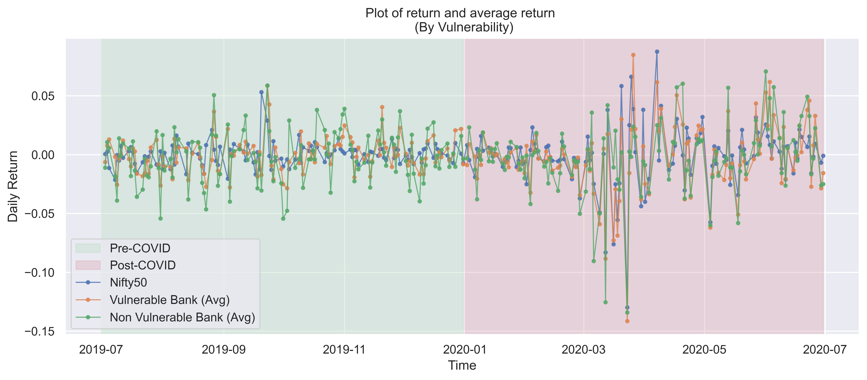
Exploratory Data Analysis

Slide 9
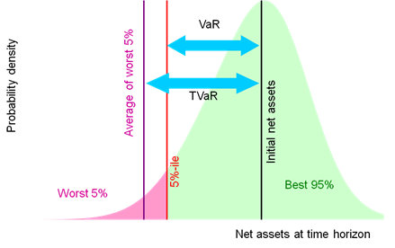
Methodology-I
Calculating Marginal Expected Shortfall
MES: Measure of expected equity loss.
Threshold to measure vulnerability: 5%
$$MES_{i,t}=E_{t}(r_{i, t+1}|r_{m, t+1}<q_{α,t}\left(r_{t+1}\right)=c)$$
Where c is a constant defined as tail risk in the market
(Credit: http://www.nematrian.com/TailValueAtRisk)

Slide 10
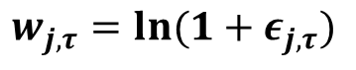
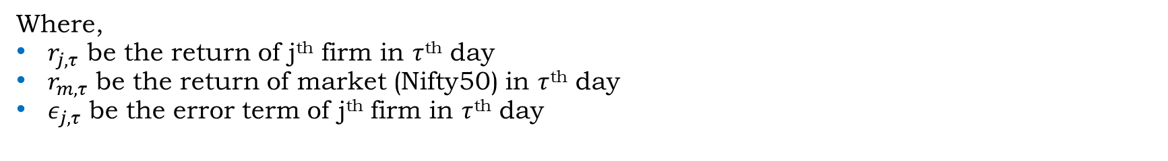
Methodology-II
Firm specific daily return
Expanded market model regression
$$r_{j,r}=α_{j}+γ_{1,j}r_{m, τ−2}+γ_{2,j}r_{m, τ−1}+γ_{3,j}r_{m, τ}+γ_{4,j}r_{m, τ+1}+γ_{5,j}r_{m, τ+2}+ε_{j, τ}$$
Where,
$r_{j, τ}$ be the return of j^{th} firm in $τ$^{th} day
$r_{m, τ}$ be the return of market (Nifty50) in $τ$^{th} day
$ε_{j, τ}$ be the error term of j^{th} firm in $τ$^{th} day
The firm specific daily return for the $j$ in day $τ$ is calculated as the natural logarithm of one plus the residual return.
$$w_{j, τ}=ln(1+ε_{j, τ})$$

Slide 11
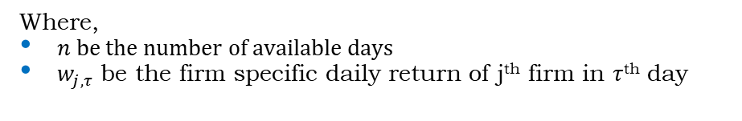
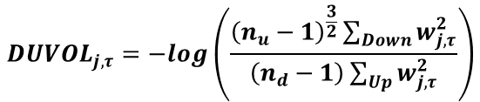
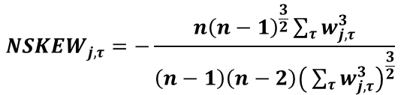
Methodology-III
1. NSKEW
This measure captures the asymmetry of the return distribution of the firm. Negative (positive) values for the skewness indicate data that are skewed to the left (right). NSKEW is calculated by taking the negative of the third moment of firm specific daily returns for each day and normalising it by the standard deviation firm-specific daily returns raised to the third power. This measure is multiplied by -1 So, that a higher value corresponds to greater crash risk.
$$NSKEW_{j,τ}=−\frac{n{\left(n−1\right)}^{\frac{3}{2}}\sum_{τ}{w_{j, τ}^{3}}}{\left(n−1\right)\left(n−2\right){\left( \sum_{τ}{w_{j, τ}^{3}}\right)}^{\frac{3}{2}}}$$
Where,
$n$ be the number of available days
$w_{j, τ}$ be the firm specific daily return of j^{th} firm in $τ$^{th} day
2. DUVOL
This is the down to top volatility measure of the crash likelihood. A higher value of the DUVOL indicated greater crash risk. DUVOL does not involve third moments and hence is less likely to be overly influenced by extreme daily returns.
$$DUVOL_{j, τ}=−log\left(\frac{{\left(n_{u}−1\right)}^{\frac{3}{2}}\sum_{Down}{w_{j, τ}^{2}}}{\left(n_{d}−1\right)\sum_{Up}{w_{j, τ}^{2}}}\right)$$

Slide 12
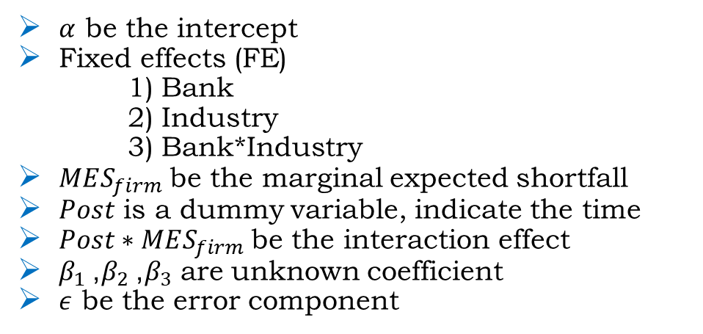
Model
DID Panel data regression
$$Crash Risk=α+FE+β_{1}MES_{firm}+β_{2}Post+β_{3}Post∗MES_{firm}+ε$$
Where,
$α$ be the intercept
Fixed effects (FE)
1) Bank
2) Industry
3) Bank*Industry
$MES_{firm}$ be the marginal expected shortfall
$Post$ is a dummy variable, indicate the time
$Post∗MES_{firm}$ be the interaction effect
$β_{1}$, $β_{2}$, $β_{3}$ are unknown coefficient
$ε$ be the error component

Slide 13
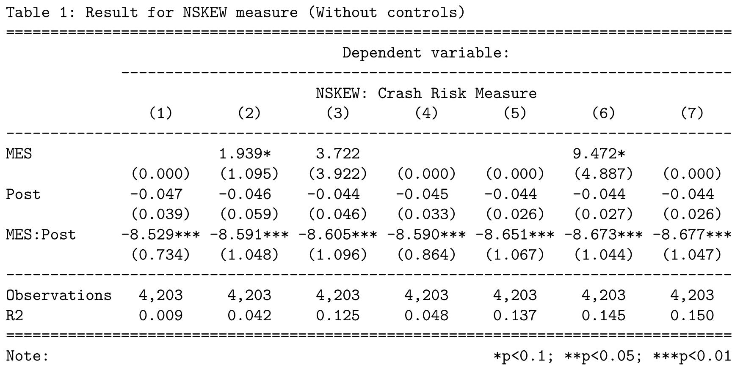
Result I
NSKEW
(Without Controls)
How much crash risk change?
On average, during the crisis time crash risk is less than before. But it is not significant.
Does the time difference in crash risk differ based on the MES measure?
The interaction is significant.
Crash risk gap is not same for every level of MES.
Reduction in the crash risk for those firms that took loan from the vulnerable banks.
Bank-FE | Y | N | N | Y | Y | N | Y
Industry-FE | N | Y | N | Y | N | Y | Y
Bank * Industry-FE | N | N | Y | N | Y | Y | Y
Controls | N | N | N | N | N | N | N

Slide 14
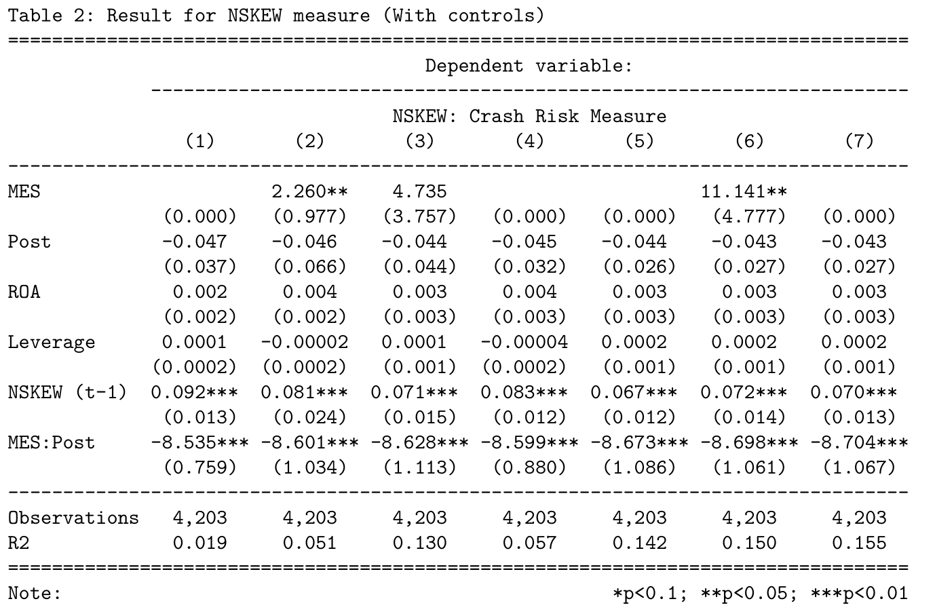
Result II
NSKEW
(With Controls)
How much crash risk change?
On average, after the crisis time crash risk is less than before. But it is not significant.
Does the time difference in crash risk differ based on the MES measure?
The interaction is significant.
Crash risk gap is not same for every level of MES.
Reduction in the crash risk for those firms that took loan from the vulnerable banks.
Bank-FE | Y | N | N | Y | Y | N | Y
Industry-FE | N | Y | N | Y | N | Y | Y
Bank * Industry-FE | N | N | Y | N | Y | Y | Y
Controls | Y | Y | Y | Y | Y | Y | Y

Slide 15
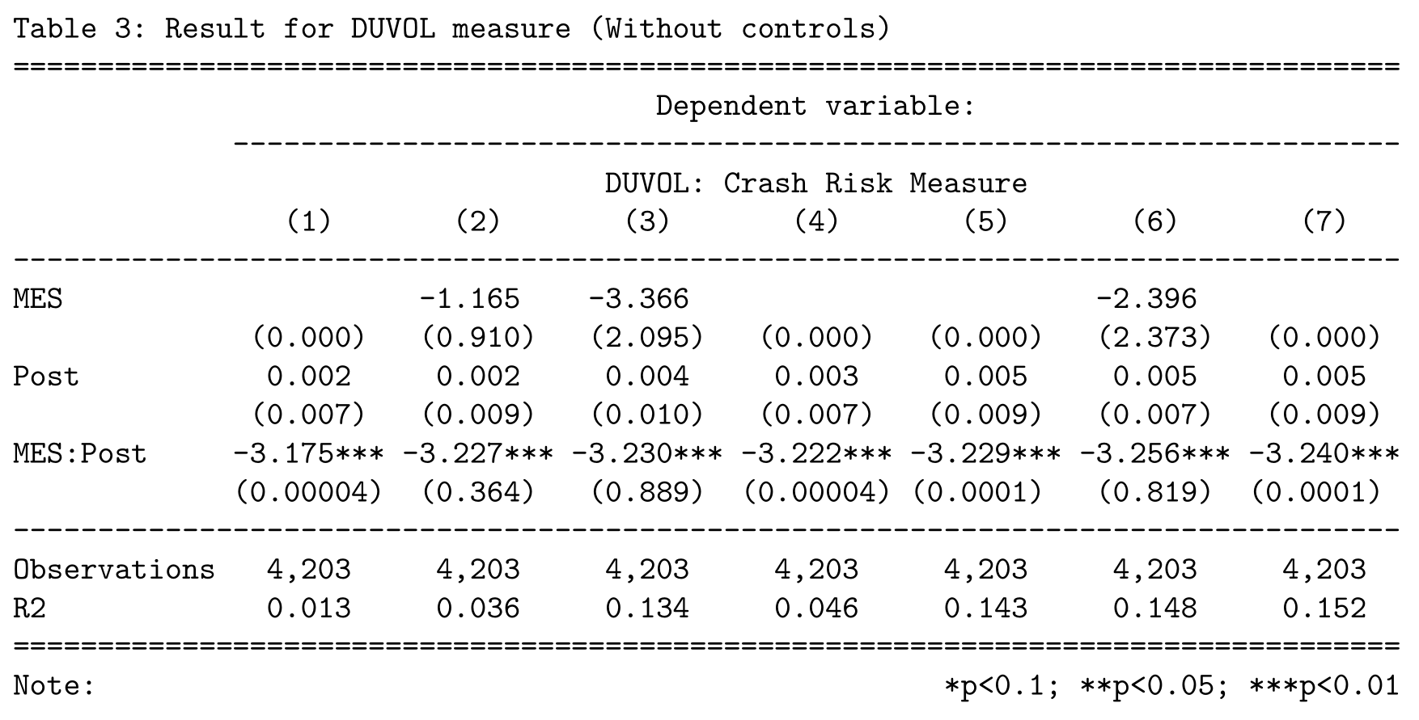
Result III
DUVOL
(Without Controls)
How much crash risk change?
On average, after the crisis time crash risk is more than before. But it is not significant.
Does the time difference in crash risk differ based on the MES measure?
The interaction is significant.
Crash risk gap is not same for every level of MES.
Reduction in the crash risk for those firms that took loan from the vulnerable banks.
Bank-FE | Y | N | N | Y | Y | N | Y
Industry-FE | N | Y | N | Y | N | Y | Y
Bank * Industry-FE | N | N | Y | N | Y | Y | Y
Controls | N | N | N | N | N | N | N

Slide 16
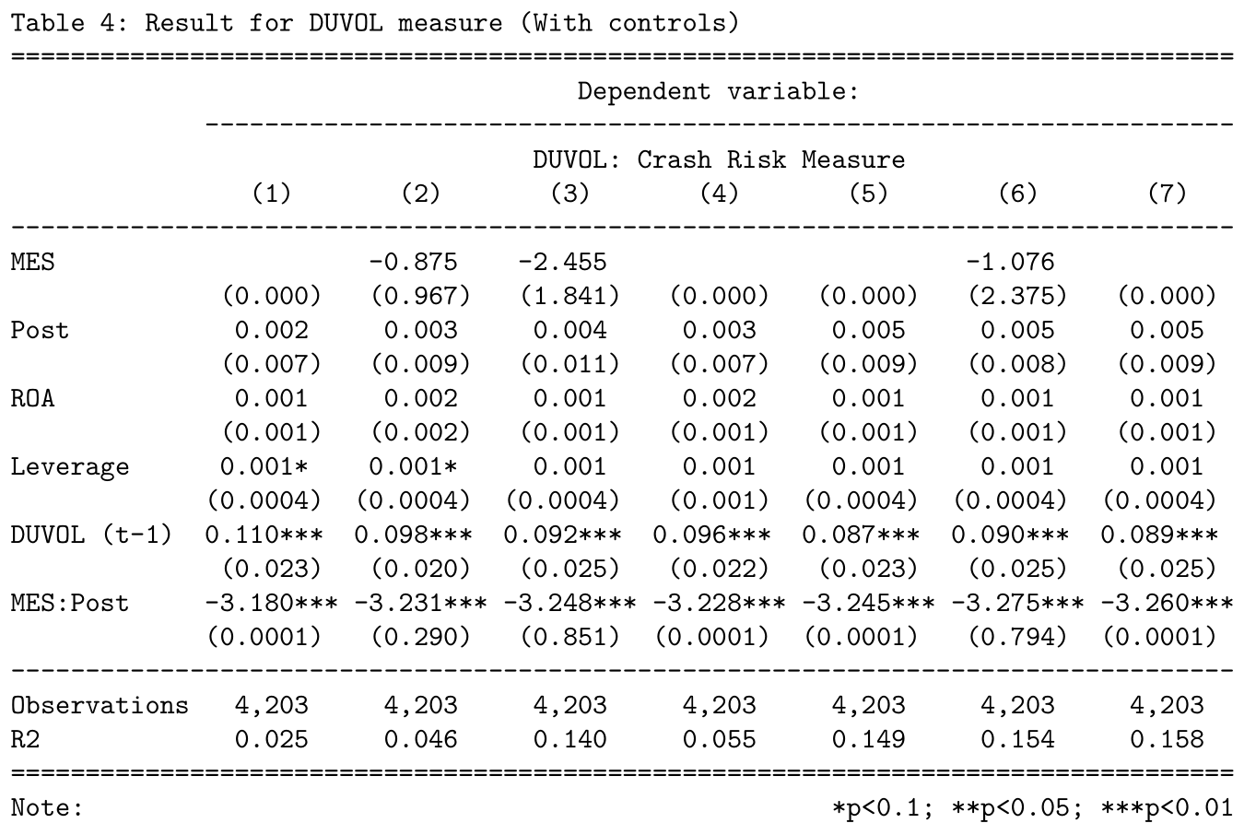
Result IV
DUVOL
(With Controls)
How much crash risk change?
On average, after the crisis time crash risk is more than before. But it is not significant.
Does the time difference in crash risk differ based on the MES measure?
The interaction is significant.
Crash risk gap is not same for every level of MES.
Reduction in the crash risk for those firms that took loan from the vulnerable banks.
Bank-FE | Y | N | N | Y | Y | N | Y
Industry-FE | N | Y | N | Y | N | Y | Y
Bank * Industry-FE | N | N | Y | N | Y | Y | Y
Controls | Y | Y | Y | Y | Y | Y | Y

Slide 17
Conclusion
There could be many reason for this, some of them are
Tightening monitoring/scrutinizing
More regularities
Because of COVID19, COVID shock brought many regularities changes to bring more transparency and monitoring in the economy. Because of this (plausible reason) crash risk got reduce for those firms that took loan from vulnerable bank.

Slide 18
Reference
Acharya, V. V., & Kulkarni, N. (2019). Government guarantees and bank vulnerability during a crisis: Evidence from an emerging market (No. w26564). National Bureau of Economic Research.
Habib, A., Hasan, M. M., & Jiang, H. (2018). Stock price crash risk: review of the empirical literature. Accounting & Finance, 58, 211-251.
Acharya, V. V., Anshuman, V. R., & Kumar, K. K. (2022). Foreign Fund Flows and Equity Prices During COVID-19: Evidence from India. Emerging Markets Finance and Trade, 1-18.
Angrist, J. D., & Pischke, J. S. (2009). Mostly harmless econometrics: An empiricist's companion. Princeton university press.
https://prowessiq.cmie.com/

Slide 19
Thank You

